Slide 2
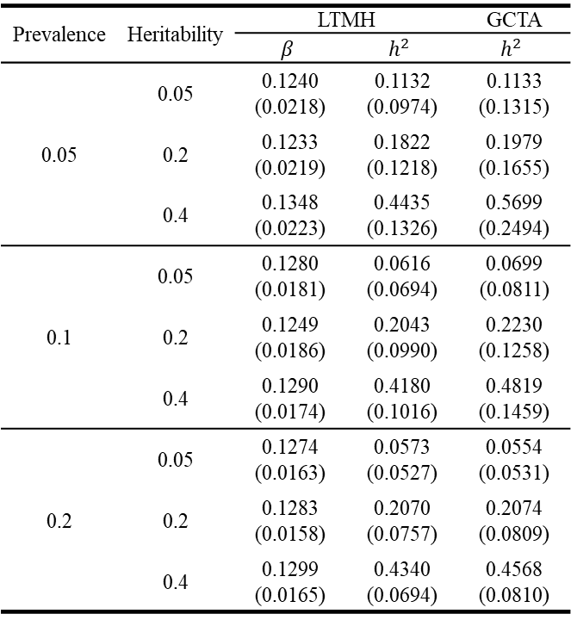
table 1
Prevalence | Heritability | LTMH |  | GCTA
 |  | $$β$$ | $$h^{2}$$ | $$h^{2}$$
0.05 | 0.05 | 0.1240 (0.0218) | 0.1132 (0.0974) | 0.1133 (0.1315)
 | 0.2 | 0.1233 (0.0219) | 0.1822 (0.1218) | 0.1979 (0.1655)
 | 0.4 | 0.1348 (0.0223) | 0.4435 (0.1326) | 0.5699 (0.2494)
0.1 | 0.05 | 0.1280 (0.0181) | 0.0616 (0.0694) | 0.0699 (0.0811)
 | 0.2 | 0.1249 (0.0186) | 0.2043 (0.0990) | 0.2230 (0.1258)
 | 0.4 | 0.1290 (0.0174) | 0.4180 (0.1016) | 0.4819 (0.1459)
0.2 | 0.05 | 0.1274 (0.0163) | 0.0573 (0.0527) | 0.0554 (0.0531)
 | 0.2 | 0.1283 (0.0158) | 0.2070 (0.0757) | 0.2074 (0.0809)
 | 0.4 | 0.1299 (0.0165) | 0.4340 (0.0694) | 0.4568 (0.0810)

Slide 3
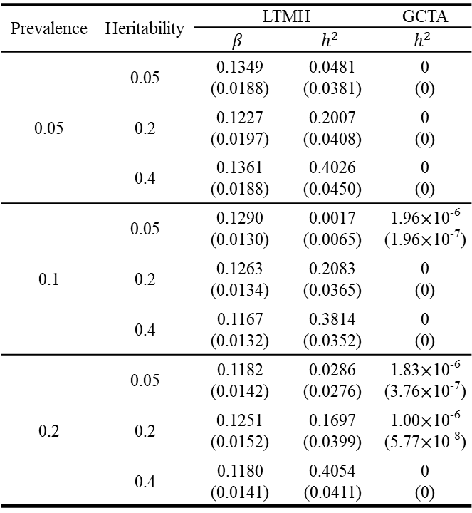
table 2
Prevalence | Heritability | LTMH |  | GCTA
 |  | $$β$$ | $$h^{2}$$ | $$h^{2}$$
0.05 | 0.05 | 0.1349 (0.0188) | 0.0481 (0.0381) | 0 (0)
 | 0.2 | 0.1227 (0.0197) | 0.2007 (0.0408) | 0 (0)
 | 0.4 | 0.1361 (0.0188) | 0.4026 (0.0450) | 0 (0)
0.1 | 0.05 | 0.1290 (0.0130) | 0.0017 (0.0065) | 1.96$×$10⁻⁶ (1.96$×$10⁻⁷)
 | 0.2 | 0.1263 (0.0134) | 0.2083 (0.0365) | 0 (0)
 | 0.4 | 0.1167 (0.0132) | 0.3814 (0.0352) | 0 (0)
0.2 | 0.05 | 0.1182 (0.0142) | 0.0286 (0.0276) | 1.83$×$10⁻⁶ (3.76$×$10⁻⁷)
 | 0.2 | 0.1251 (0.0152) | 0.1697 (0.0399) | 1.00$×$10⁻⁶ (5.77$×$10⁻⁸)
 | 0.4 | 0.1180 (0.0141) | 0.4054 (0.0411) | 0 (0)

Slide 4
table 3
Heritability | Significance level | Prevalence
 |  | 0.05 | 0.1 | 0.2
0 | 0.01 | 0.0015 | 0.0050 | 0.0015
 | 0.05 | 0.0115 | 0.0480 | 0.0200
 | 0.1 | 0.0285 | 0.1020 | 0.0505
0.2 | 0.01 | 0.0485 | 0.3420 | 0.6210
 | 0.05 | 0.2260 | 0.6730 | 0.8675
 | 0.1 | 0.3990 | 0.8055 | 0.9405
0.4 | 0.01 | 0.4575 | 0.9395 | 1.0000
 | 0.05 | 0.8190 | 0.9930 | 1.0000
 | 0.1 | 0.9050 | 0.9960 | 1.0000

Slide 5
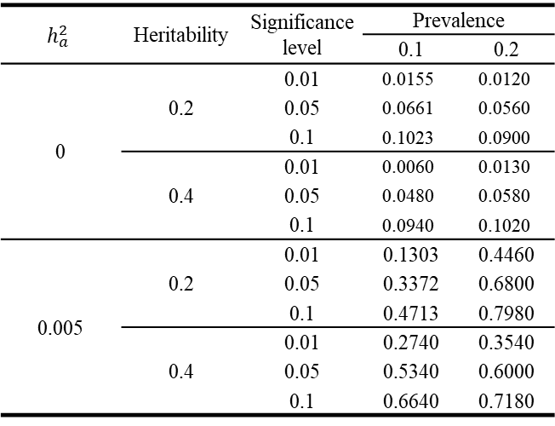
table 5
$$h_{a}^{2}$$ | Heritability | Significance level | Prevalence
 |  |  | 0.1 | 0.2
0 | 0.2 | 0.01 | 0.0155 | 0.0120
 |  | 0.05 | 0.0661 | 0.0560
 |  | 0.1 | 0.1023 | 0.0900
 | 0.4 | 0.01 | 0.0060 | 0.0130
 |  | 0.05 | 0.0480 | 0.0580
 |  | 0.1 | 0.0940 | 0.1020
0.005 | 0.2 | 0.01 | 0.1303 | 0.4460
 |  | 0.05 | 0.3372 | 0.6800
 |  | 0.1 | 0.4713 | 0.7980
 | 0.4 | 0.01 | 0.2740 | 0.3540
 |  | 0.05 | 0.5340 | 0.6000
 |  | 0.1 | 0.6640 | 0.7180

Slide 6
table 6
Heritability | Significance level | Prevalence
 |  | 0.1 | 0.2
0.2 | 0.01 | 0.1303 | 0.4460
 | 0.05 | 0.3372 | 0.6800
 | 0.1 | 0.4713 | 0.7980
0.4 | 0.01 | 0.2740 | 0.3540
 | 0.05 | 0.5340 | 0.6000
 | 0.1 | 0.6640 | 0.7180

Slide 7
table 7
 | Proband | Non-proband
Disease status
T2D | 648 (100%) | 1,115 (26.87%)
Normal | 0 (0%) | 3,034 (73.13%)
Sex
Male | 308 (47.53%) | 2,058 (49.6%)
Female | 340 (52.47%) | 2,091 (50.4%)
Age | 55.44 (10.7) | 47.56 (16.09)
Relationship of relatives with proband
Parents |  | 329 (7.93%)
Sibling |  | 2,457 (59.22%)
Offspring |  | 1,363 (32.85%)

